Slide 1
Dr. Phillip Carpenter pcarpenter@med-pathway.com
medpathwaymcat
Med-pathway
ENZYME KINETICS

Slide 2
Kinetics & Thermodynamics
Chemical reactions result in changes in
energy that result from the formation and dissociation of bonds.
Kinetics deals with how to actually perform a chemical reaction on an appropriate
time scale and how to find a reaction pathway that accomplishes this.
Thermodynamics tells us whether or not we can harvest
the free energy present in chemical bonds (i.e. spontaneous)
Diamond Graphite

Slide 3
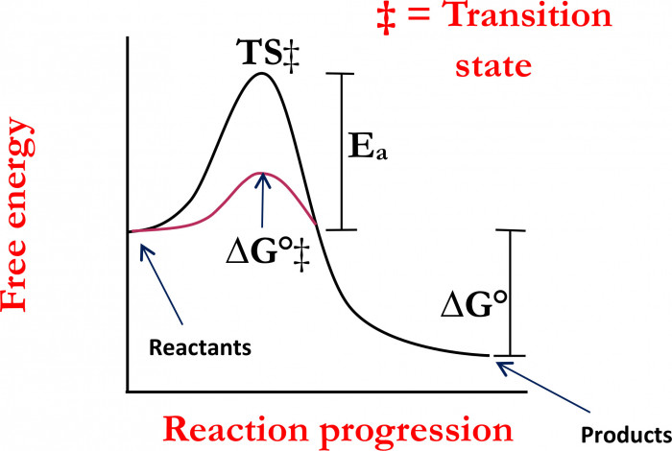
Kinetics & Thermodynamics
Kinetics: How fast the reaction proceeds from Reactants to Products
Thermo: Describes the relative levels of Reactants/Products at equilibrium
Gibbs free energy: Maximal energy that can be harnessed from chemical bonds
ΔG° = ΔH° - TΔS°
Standard Gibbs Free
Energy Change
Exergonic

Slide 4
Reaction Rates & Arrhenius Equation
Reaction Rates Depend on Temperature & Frequency of collisions
The rate constant(k) is dependent on the activation energy (E_{a}), the Arrhenius factor (A),
temperature (t), and the ideal gas constant (R).
Frequency factor
ln k
Slope = -E_{A}/R
ln K = -E_{A}/R(1/T) + ln A
1/T
y = m (x) + b

Slide 5
Kinetic vs Thermodynamic Control
CH₂=CHCH=CH₂ + HBr
CH₃CHCH=CH₂
CH₃CH=CHCH₂
Br
Br
1, 3 butadiene
(1, 2 addition)
(1, 4 addition)

Slide 6
Kinetic vs Thermodynamic Control
CH₂=CHCH=CH₂ + H-Br
CH₃CHCH=CH₂
CH₃CH=CHCH₂
Br
Br
(1, 2 addition)
(1, 4 addition)
CH₂=CHCHCH₃ + Br ⁻
+
Common Intermediate

Slide 7
Kinetic vs Thermodynamic Control
CH₂=CHCH=CH₂ + HBr
CH₃CHCH=CH₂
CH₃CH=CHCH₂
Br
Br
1, 3 butadiene
Kinetic
(1, 2 addition)
Thermodynamic
(1, 4 addition)
0 °C 70% 30%
40 °C 15% 85%

Slide 8
Kinetic vs Thermodynamic Control
CH₂=CHCH=CH₂ + HBr
CH₃CHCH=CH₂
CH₃CH=CHCH₂
Br
Br
1, 3 butadiene
Kinetic
(1, 2 addition)
Thermodynamic
(1, 4 addition)
0 °C 70% 30%
40 °C 15% 85%
Proton
Transfer
+
CH₃CH=CHCH₂
Nucleophilic
Attack
Free Energy
Common
Intermediate
CH₃CHCH=CH₂
+
CH₃CHCH=CH₂
Br
CH₃CH=CHCH₂
Reaction Progress
Br
Kinetic: Predominates when Reaction is Irreversible (Low Temp)
Thermodynamic: Predominates when Reaction is Reversible (High Temp)

Slide 9
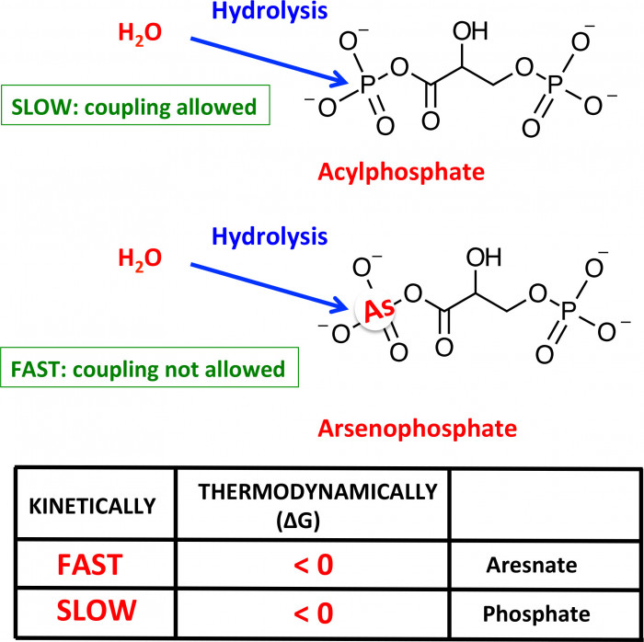
Kinetic Control
1, 3 Biphosphoglycerate + ADP + Pi 3-Phosphoglycerate + ATP

Slide 10
Reaction Order: Relationship b/t [ ] & Reaction Rate
Zero Order Reactions (r = k)
Alcohol Dehydrogenase
Ethanol + NAD⁺ + H⁺ Acetaldehyde + NADH
Zero order
Zero Order
Rate of Reaction
[Ethanol]
[Time]
Time
Rate of oxidation of ethanol is constant
until alcohol has been consumed;
Rate is determined by the [Enzyme] not
the amount of alcohol
Linear change in concentration
as a function of time

Slide 11
First Order of Reactions: r = k[A]
First order: Rate is proportional
to concentration of one of the reactants
Integrated rate law
Integrated rate law
[A] = [A]_{o}e^{-kt}
ln[A] = ln[A]_{o} - kt
Slope = -k
[Concentration]
ln [concentration]
Time
Time

Slide 12
Experimental Determination of Rate Laws
A + B C Order of Reaction?? Rate Law??
General Rate Law = r = k[A]^{m}[B]^{n}
[A]
[B]
Initial Rate (mM/min)
Experiment 1
Experiment 2
Experiment 3
Experiment 4
0.40 mM
0.40 mM
.009
0.80 mM
0.20 mM
.036
0.80 mM
0.40 mM
.036
0.40 mM
0.80 mM
.009
Rate 1 = k[A₁]^{m} [B₁]^{n}
k[0.4]^{m}[0.4]^{n}
.009
=
=
=
0.25
Rate 3 = k[A₃]^{m} [B₃]^{n}
k[0.8]^{m}[0.4]^{n}
.036
Simplify equation: ½ = (¼)^{m} m = 2 n = 0 Rate Law: r = k[A]²
Rate law cannot be determined from reaction equation!

Slide 13
2nd order Kinetics r = k[A]²
[Concentration]
1st order
2nd order
Time

Slide 14
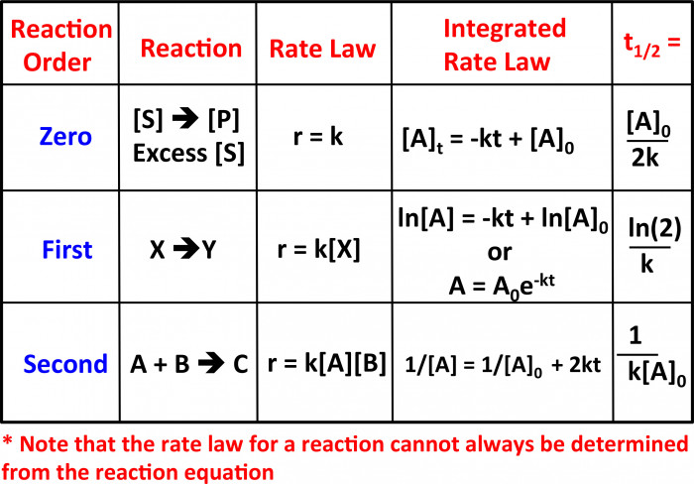
Rate Laws
UNITS
M/s
1/s
1/M s
r = k[A]²

Slide 15
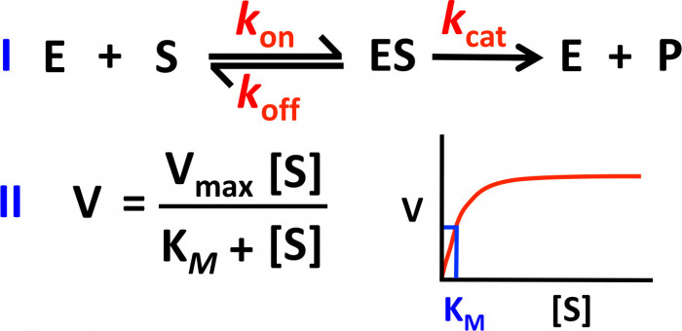
Michaelis Menten Kinetics
k_{on} = k₁
k_{off} = k₋₁
k_{cat} = k₂
Zero order
k_{M} = [S] at ½ V_{max} (inverse of affinity)
k_{cat} = V_{max}/[E] turnover number
k_{cat}/K_{M} = catalytic efficiency

Slide 16
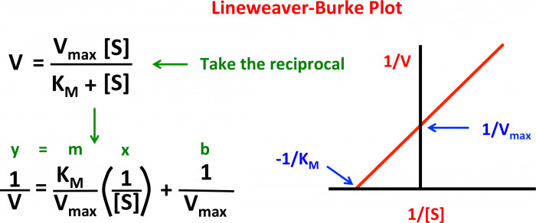
Lineweaver Burk Plot
0
Double Reciprocal Plot

Slide 17
Competitive Inhibition
E + I = EI
EI + S = E + P + I
S
S
S
S
I
S
S
S
S
E
I
E
I
I
I
S
I
1/V
+ I
- I
V
+ I
1/V_{max}
-1/K_{M}
- I
K_{M} increases
K_{M}
K_{i}
[S]
1/S

Slide 18
Noncompetitive Inhibition
S
E + I = EI
EI + S = ESI
E + I + S = E + P
E
I
1/V
+ I
- I
- I
V
+ I
K_{M} remains the same
K_{i} =
K_{M}
[S]
1/S

Slide 19
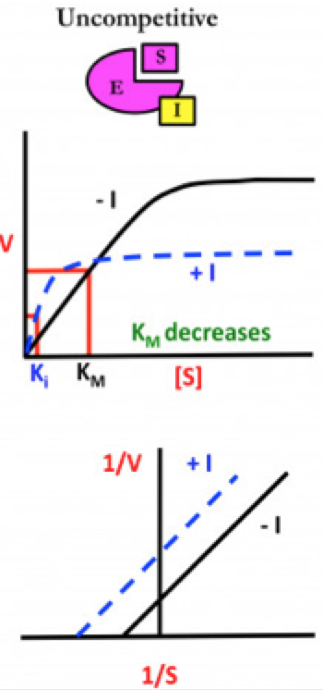
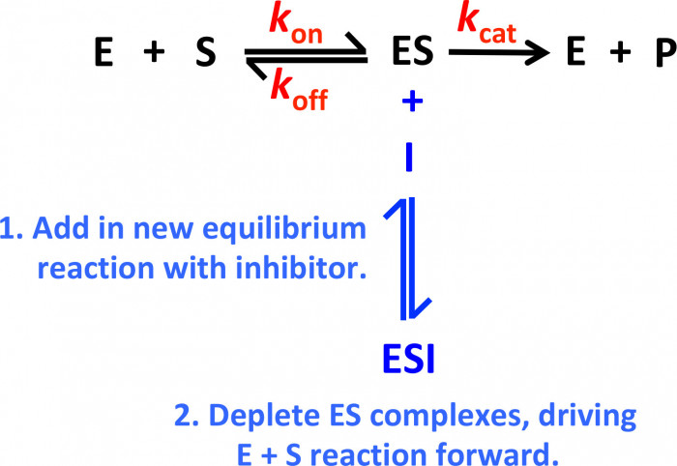
Uncompetitive Inhibition: ES + I = (ES)I

Slide 20
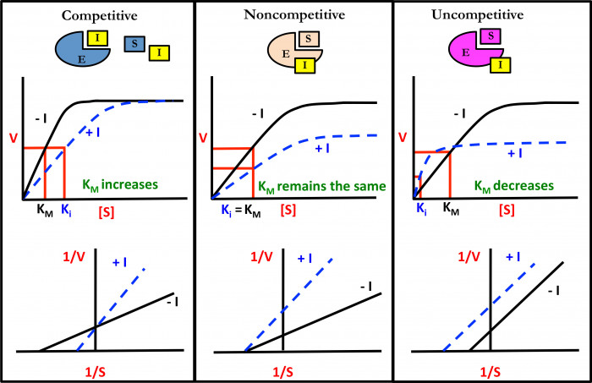
Comparison of Enzyme Inhibition Mechanisms

Slide 21
Mixed Inhibition
E + S
ES
E + P
+
+
I
I
EI
ESI
Competitive
Uncompetitive
1/V
+ I
- I
1/S
Change in K_{M} and V_{max}

Slide 22
Comparison of Enzyme Inhibition Mechanisms
Type of Inhibition
V_{max}
K_{M}
Competitive
No change
Noncompetitive
No change
Uncompetitive
Mixed*
Varies
*Competitive & Uncompetitive
**Depends on whether inhibitor
Favors binding to Enzyme or ES

Slide 23
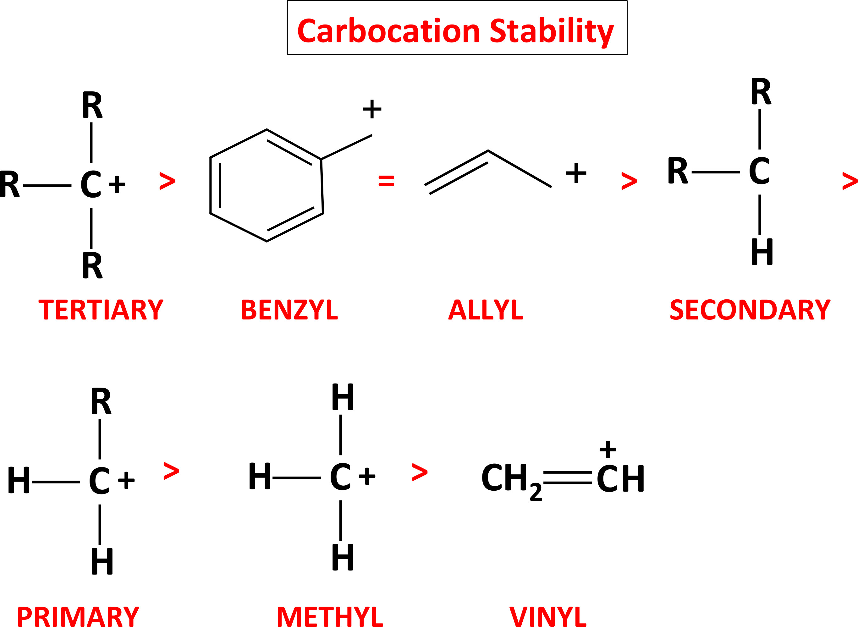
S_{N}1 Reactions
S_{N}1 = Substitution Nucleophilic First order
Rate Law: r = k[electrophile]
Proceeds Through Carbocation intermediate
+

Slide 24
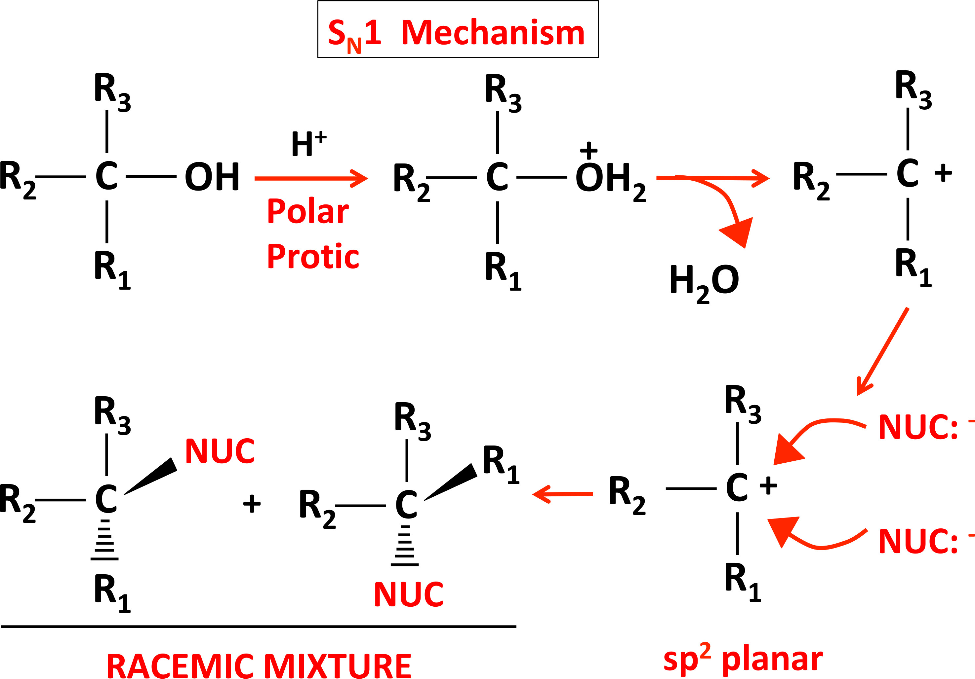
S_{N}1 Mechanism
Tertiary alcohol

Slide 25
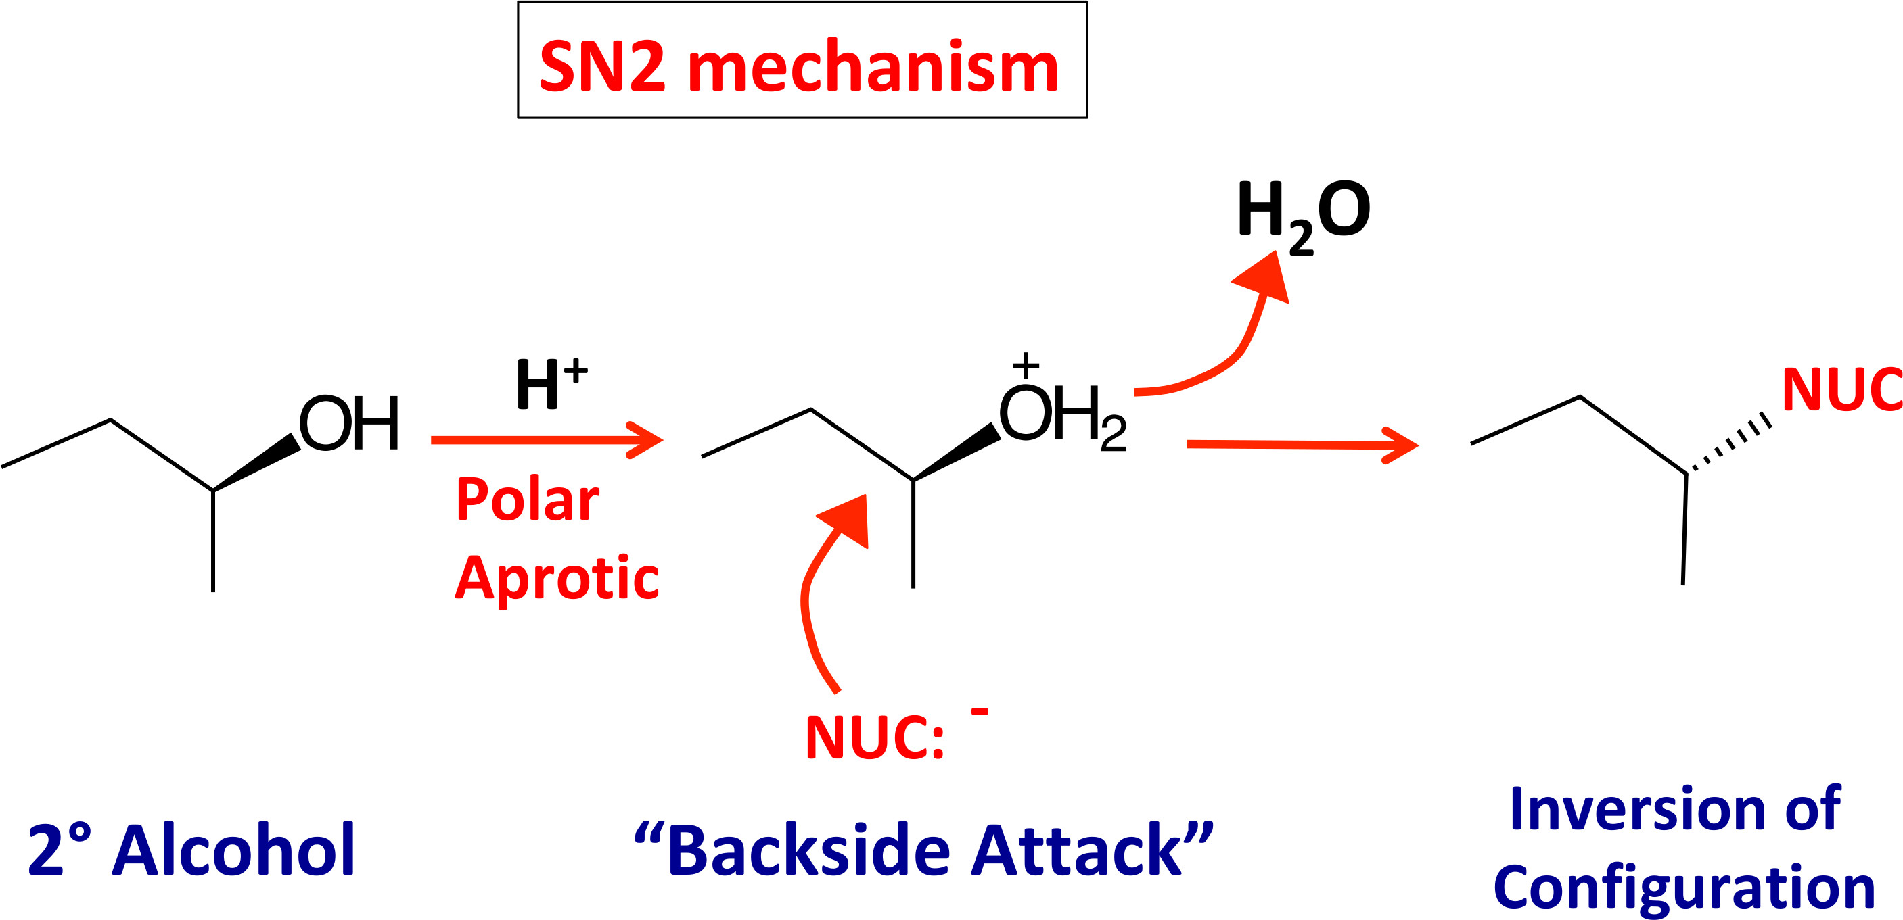
S_{N}2 Reactions
S_{N}2 = Substitution Nucleophilic Second order
Rate Law: r = k[electrophile][nucleophile]
Proceeds Through Inversion of Configuration

Slide 26
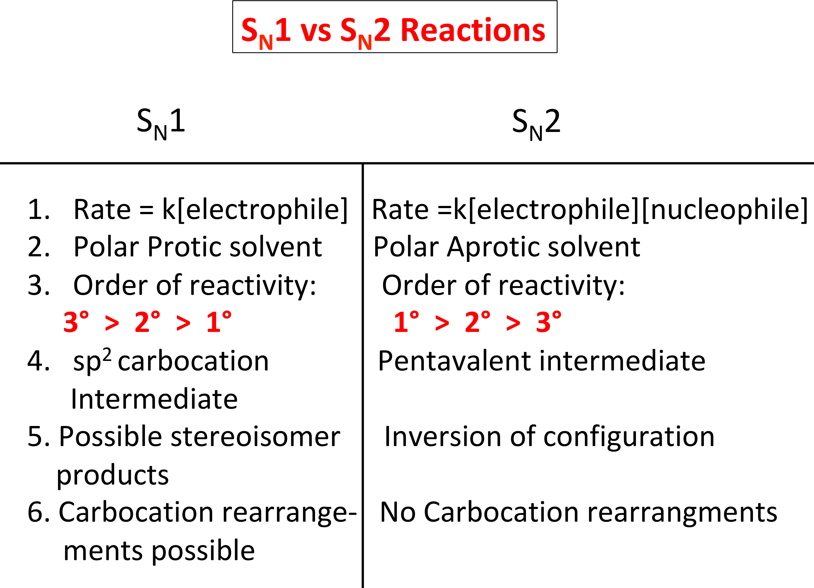
S_{N}1 vs S_{N}2

Slide 27
Workshop Passage
www.med-pathway.com/register

Slide 28
Dr. Phillip Carpenter pcarpenter@med-pathway.com
medpathwaymcat
Med-pathway
ENZYME KINETICS

Slide 29
PASSCODES

Slide 30
Kinetics of Protein Farnesylation

Slide 31
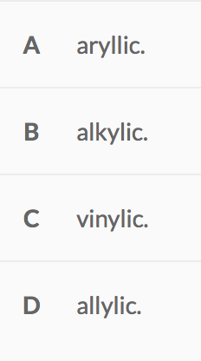
1. In an electrophilic mechanism, a carbocation intermediate is formed as shown. This primary carbocation can best be described as:

Slide 32
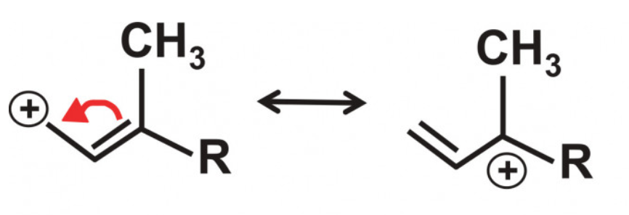
Choice D is correct (allylic)

Slide 33
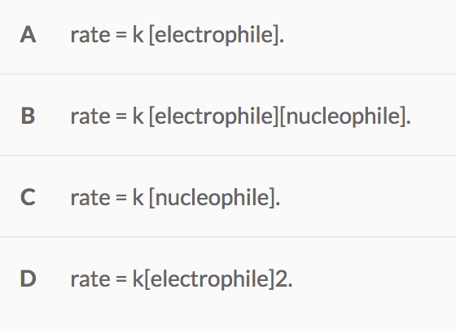
2. The following kinetic rate law best describes the farnesylation reaction:

Slide 34
2. The following kinetic rate law best describes the farnesylation reaction:

Slide 35
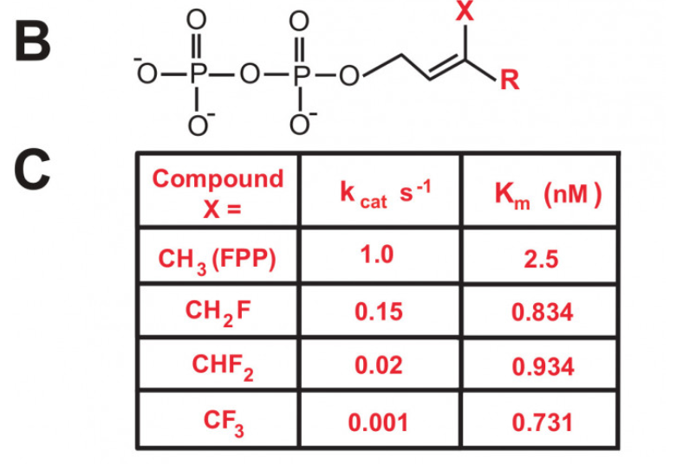
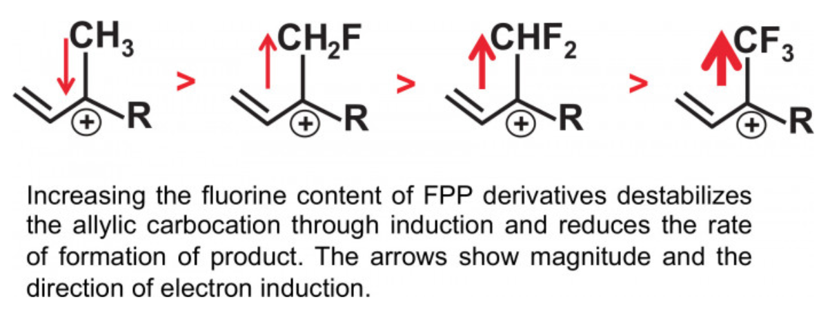
2. Choice A is correct: rate = k [electrophile]
“The enzymatic transfer of farnesyl groups was measured with a peptide substrate labeled with a fluor whose concentration does not affect reaction rates”.

Slide 36
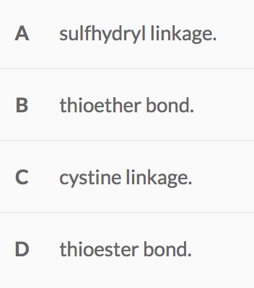
3. The alkylation between cysteine and the isoprenoid FPP occurs through a:

Slide 37
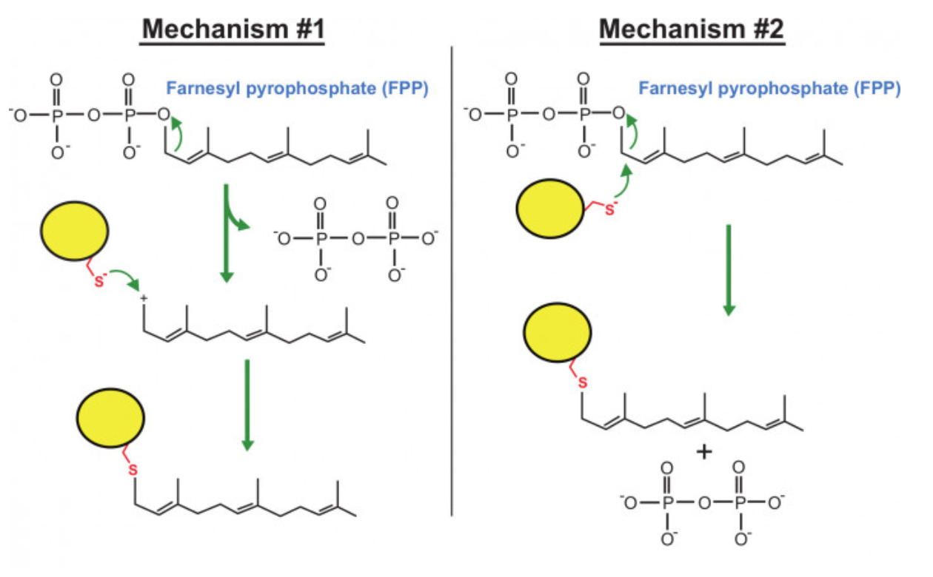
3. Choice B is correct (thioether bond)

Slide 38
4. Which of the following would be the most critical physical parameter for using the FPP analogs as an accurate assessment tool in determining the mechanism of farnesyl transfer?
A. The FPP analogs should display competitive behavior with FPP.
B. The FPP analogs should display noncompetitive behavior with FPP.
C. The FPP analogs should be required to target the farnesylated protein to the membrane.
D. The FPP analogs should bind to the enzyme with the same affinity as FPP.

Slide 39
4. Which of the following would be the most critical physical parameter for using the FPP analogs as an accurate assessment tool in determining the mechanism of farnesyl transfer?
A. The FPP analogs should display competitive behavior with FPP.
B. The FPP analogs should display noncompetitive behavior with FPP.
C. The FPP analogs should be required to target the farnesylated protein to the membrane.
D. The FPP analogs should bind to the enzyme with the same affinity as FPP.

Slide 40
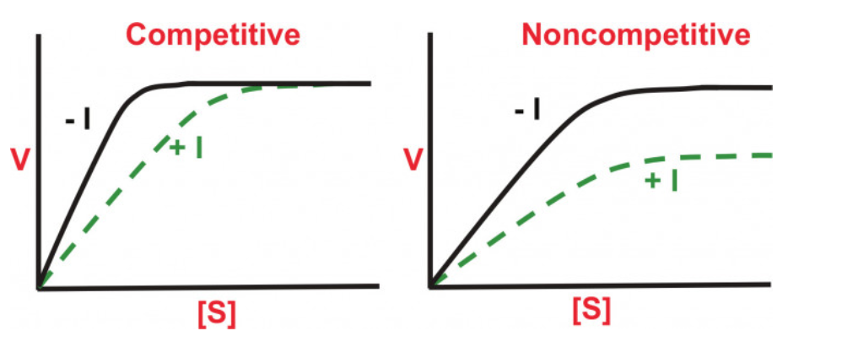
4. Choice A is correct (The FPP analogs should display competitive behavior with FPP)
The analogs must be able to bind to the active site in order to generate a product whose kinetics can be compared to the behavior with the normal FPP substrate.
FPP analogs must be able to compete with active site binding for the normal FPP itself. This is basically competitive inhibition.

Slide 41
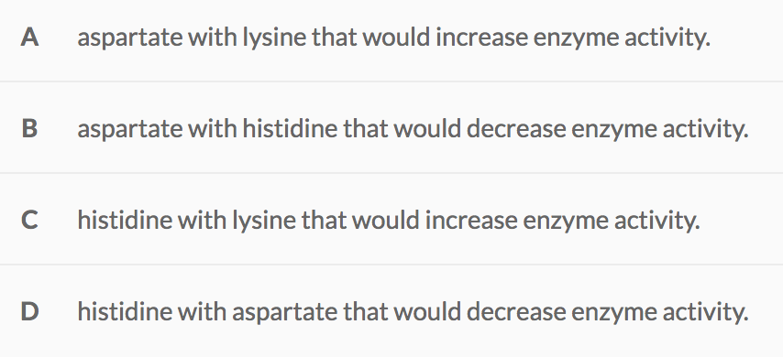
5. Mutations at amino acid residues that coordinate the zinc co-factor in a yeast farnesyltransferase can maintain zinc binding, yet change the overall charge at the zinc center from -1 to 0. This can be performed with a substitution of:

Slide 42
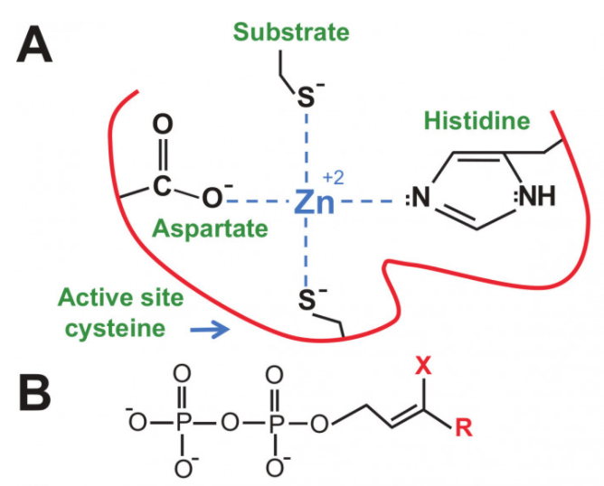
5. Choice B is correct (aspartate with histidine that would decrease enzyme activity)
Lysine
Histidine
NH₃⁺
Neutral

Slide 43
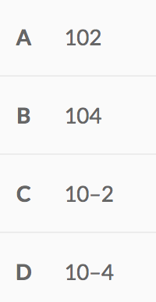
6. The pKa of the cysteine side chain in a free amino acid is approximately 9.0, but when bound as a substrate to a farnesyltransferase in a CaaX motif, the pK_{a} drops to about 5.0. Assuming that the pH of the reaction is 7.0 during catalysis, the ratio of [SH]/[S–] =

Slide 44
6. The pKa of the cysteine side chain in a free amino acid is approximately 9.0, but when bound as a substrate to a farnesyltransferase in a CaaX motif, the pKa drops to about 5.0. Assuming that the pH of the reaction is 7.0 during catalysis, the ratio of [SH]/[S–] =

Slide 45
6. Choice C is correct (10^{–2}).
pH = pK_{a} + log [A–]/[HA]
A⁻ = S⁻ HA = SH
pH = 7.0
pK_{a} = 9.0
-2 = log [A–]/[HA]
[A–]/[HA] = .01 = 1/100
[SH]/[S⁻] = 100/1 or 100 [S⁻] = [SH]
100 times more ionized cysteine.

Slide 46
Penicillinase

Slide 47
Penicillinase converts penicillin into penicillinoic acid. On this basis, the enzyme can be classified as a(n):
Oxidase
Hydrolase
Esterase
Peptidase

Slide 48
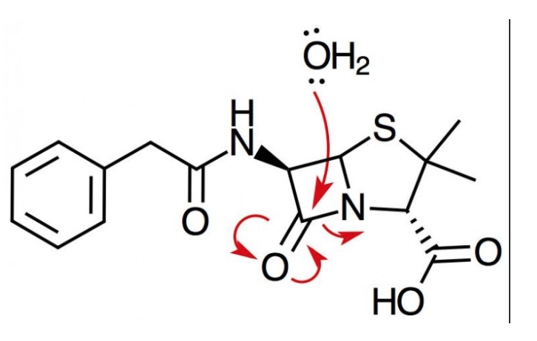
Penicillinase converts penicillin into penicillinoic acid. On this basis, the enzyme can be classified as a(n):
B. Hydrolase
hydrolysis of an amide = carboxylic acid + amine.

Slide 49
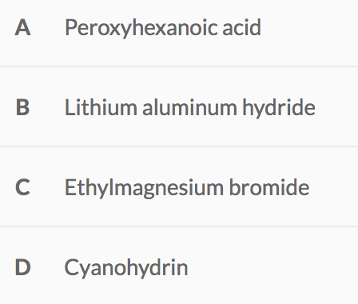
2. Which of the following reagents would be most appropriate for generating the sulfone inhibitor?

Slide 50
2. Which of the following reagents would be most appropriate for generating the sulfone inhibitor?
Carboxylic acid &
Precursors to AA
Forms C-C bonds
CHOICE A

Slide 51
3. Which of the following can be concluded regarding inhibitors 1 and 2?
A. Inhibitors 1 and 2 operate through noncompetitive and competitive inhibition, respectively.
B. Both Inhibitors 1 and 2 operate through noncompetitive inhibition.
C. Inhibitors 1 and 2 operate through competitive and noncompetitive inhibition, respectively.
D. Both Inhibitors 1 and 2 operate through competitive inhibition.

Slide 52
3. Which of the following can be concluded regarding inhibitors 1 and 2?
A. Inhibitors 1 and 2 operate through noncompetitive and competitive inhibition, respectively.
B. Both Inhibitors 1 and 2 operate through noncompetitive inhibition.
C. Inhibitors 1 and 2 operate through competitive and noncompetitive inhibition, respectively.
D. Both Inhibitors 1 and 2 operate through competitive inhibition.

Slide 53
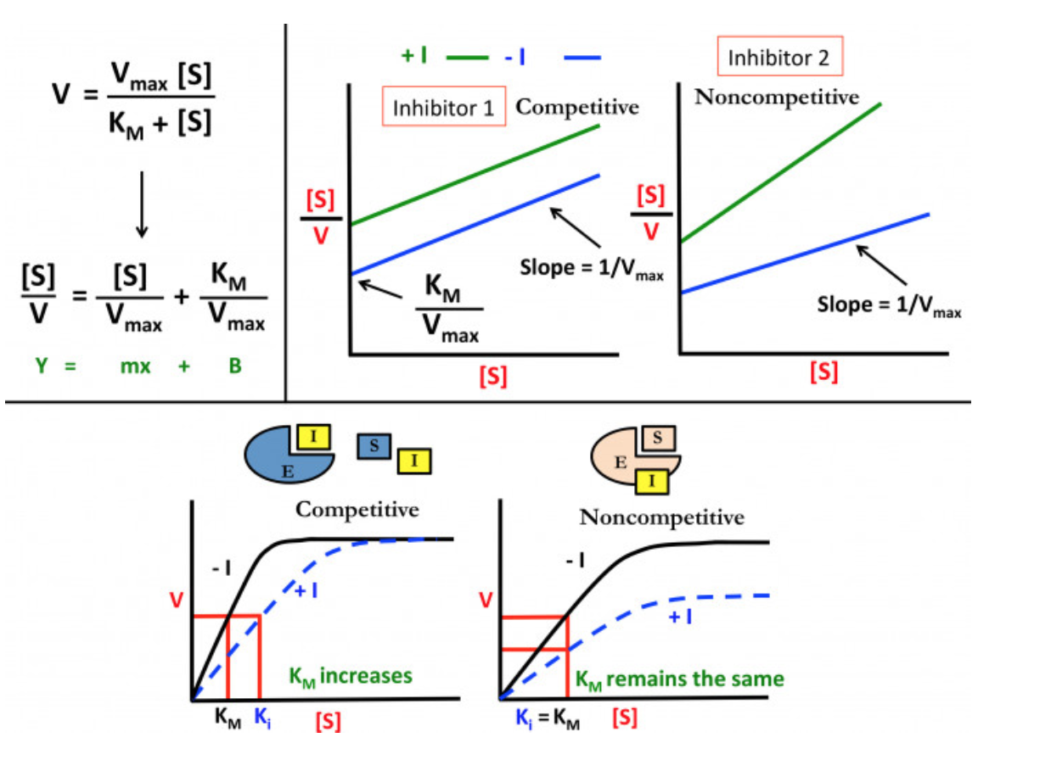
3. Which of the following can be concluded regarding inhibitors 1 and 2? CHOICE C is correct
C. Inhibitors 1 and 2 operate through competitive and noncompetitive inhibition, respectively.

Slide 54
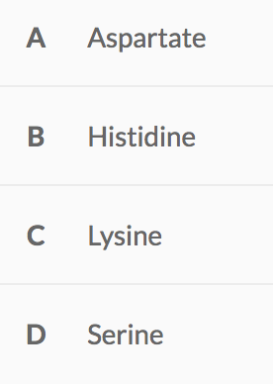
4. Penicillin becomes covalently linked to DD-transpeptidase through a ring-opening mechanism. During this process, an active site residue generates an inactivating ester linkage. Which of the following amino acid residues would be most expected to participate in this process?

Slide 55
Penicillin becomes covalently linked to DD-transpeptidase through a ring-opening mechanism. During this process, an active site residue generates an inactivating ester linkage. Which of the following amino acid residues would be most expected to participate in this process?
Choice D is correct (serine)

Slide 56
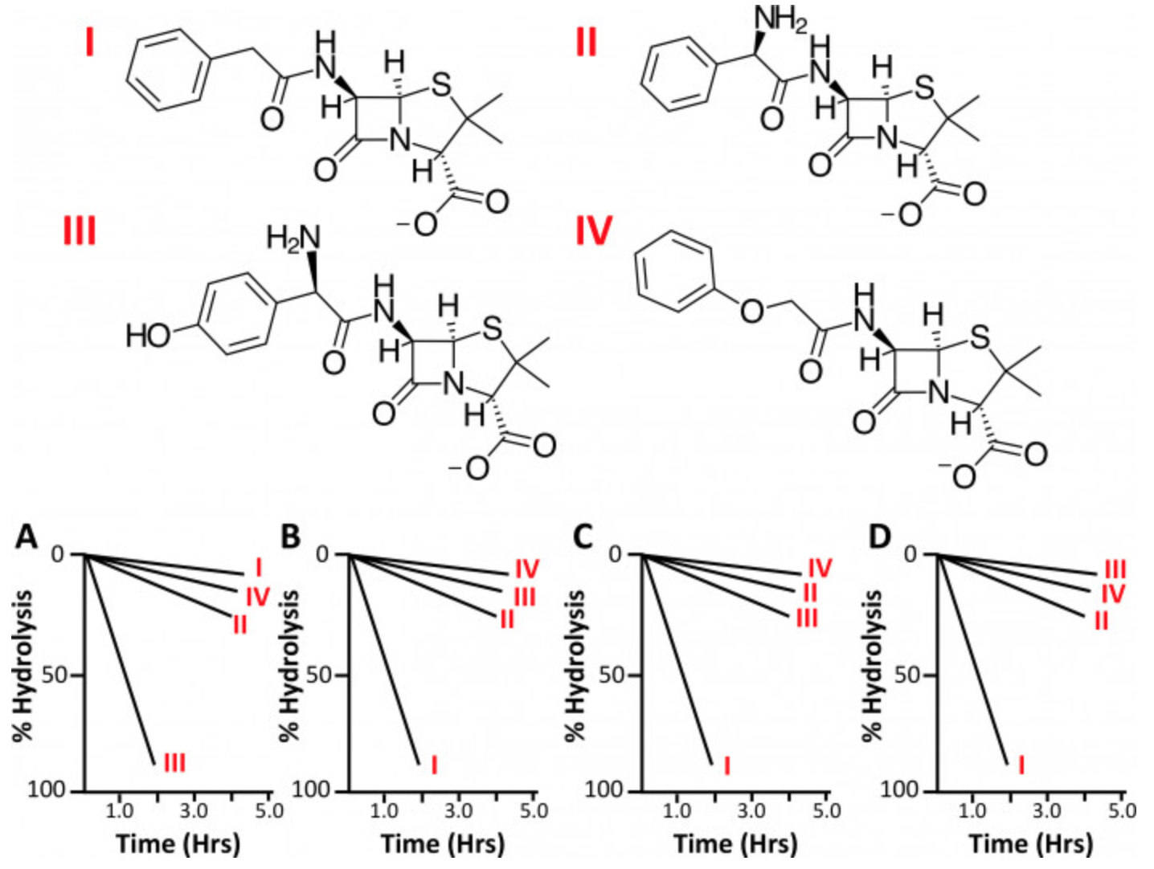
5. Additional antibiotics derived from penicillin have been developed. Their stability in acid positively correlates to the strength of electron withdrawing capacity from the penicillin core. An experiment that measured the stability of four penicillin derivatives (I-IV) as shown was conducted in the presence of an acidic solution. Which of the following experimental profiles best matches the corresponding penicillin-derived structures?

Slide 57
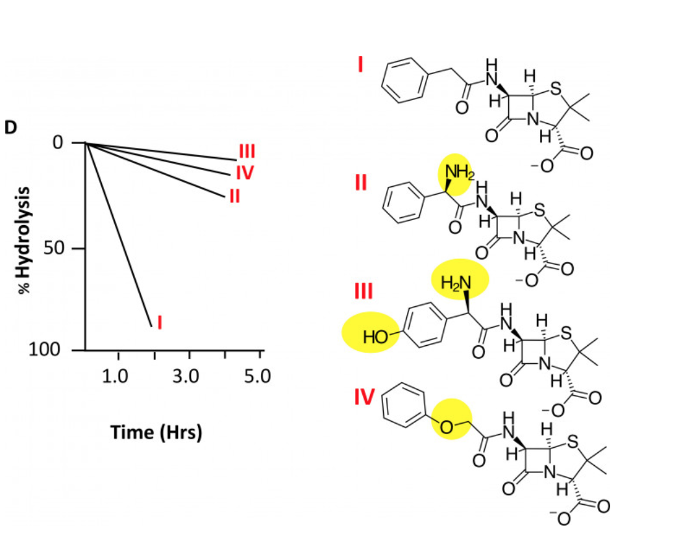
Which of the following experimental profiles best matches the corresponding penicillin-derived structures?
Strength in acid positively correlates
With strength of electron withdrawing
F > O > N

Slide 58
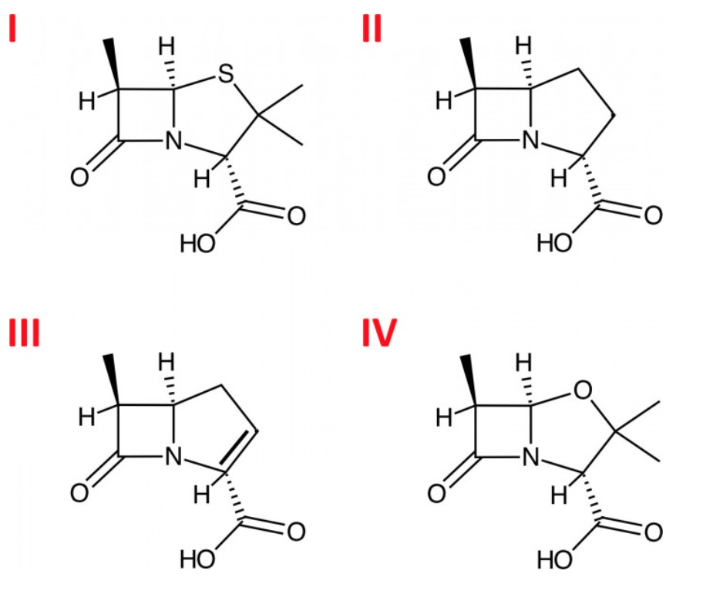
6. Penicillin and its derivatives are known as β-lactam antibiotics. β-lactams are classified according to their ring structures. For example, those β-lactams possessing a pyrrolidine ring are called carbapenams. Which of the following structures is a carbapenam?

Slide 59
